Slide 1

General –Purpose Programmable Peripheral Devices.
The 8255 Programmable Peripheral Interface(8255 PPI)

Slide 2
8255 Programmable Peripheral Interface
The 8255 is a widely used, programmable, parallel I/O device.
It can be programmed to transfer data under various conditions, from simple I/O to interrupt I/O.
It is flexible, versatile, and economical (when multiple I/O ports are required), but somewhat complex.
It is an important general-purpose I/O device that can be used with almost any microprocessor.

Slide 3
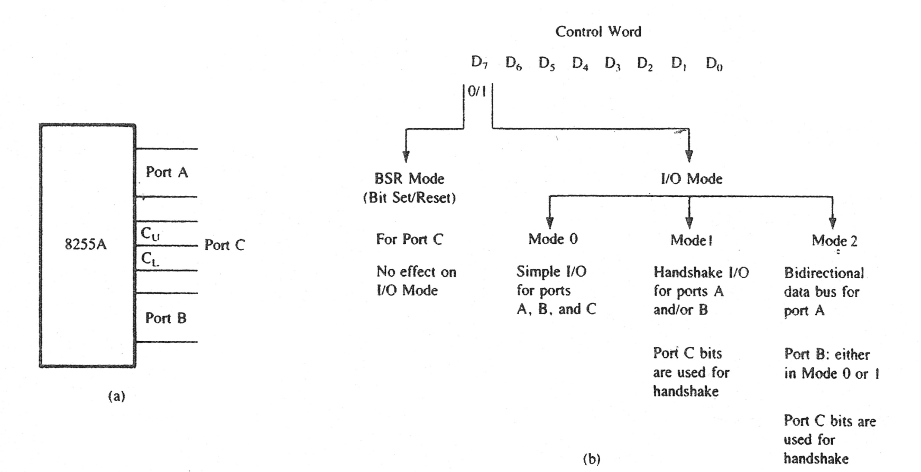
8255 I/O Ports (a) and their Modes (b)

Slide 4
8255 PPI Modes
The BSR mode is used to set or reset the bits in port C.
The I/O mode is further divided into three modes: Mode 0, Mode 1, and Mode 2.
In Mode 0, all ports function as simple I/O ports.
Mode 1 is a handshake mode whereby ports A and/or B use bits from port C as handshake signals. In the handshake mode, two types of I/O data transfer can be implemented:
(1)status check (2) interrupt.
In Mode 2, port A can be set up for bidirectional data transfer using handshake signals from port C, and port B can be set up either in Mode 0 or Mode 1.

Slide 5
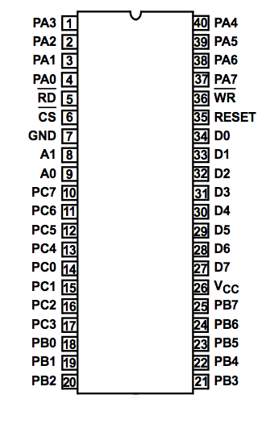
8255 Pin Description
The 8255 has 24 I/O pins that can be grouped primarily in two 8-bit parallel ports: A and B, with the remaining eight bits as port C.
The eight bits of port C can be used as individual bits or be grouped in two 4 bit ports: C_{UPPER} (C_{U}) and C_{LOWER} (C_{L}).
The functions of these ports are defined by writing a control word in the control register.

Slide 6




Function of pins
Data bus(D₀-D₇):These are 8-bit bi-directional buses, connected to 8085 data bus for transferring data.
CS: This is Active Low signal. When it is low, then data is transfer from 8085.
Read: This is Active Low signal, when it is Low read operation will be start.
Write: This is Active Low signal, when it is Low Write operation will be start.

Slide 7
Function of pins:
Address (A₀-A₁):This is used to select the ports. like this
A1 | A0 | Select
0 | 0 | PA
0 | 1 | PB
1 | 0 | PC
1 | 1 | Control reg.

Slide 8
Function of pins:
RESET: This is used to reset the device. That means clear control registers.
PA0-PA7:It is the 8-bit bi-directional I/O pins used to send the data to peripheral or to receive the data from peripheral.
PB0-PB7:Similar to PA
PC0-PC7:This is also 8-bit bidirectional I/O pins. These lines are divided into two groups.
PC0 to PC3(Lower Groups)
PC4 to PC7 (Higher groups)
These two groups working in separately using 4 data’s.

Slide 9
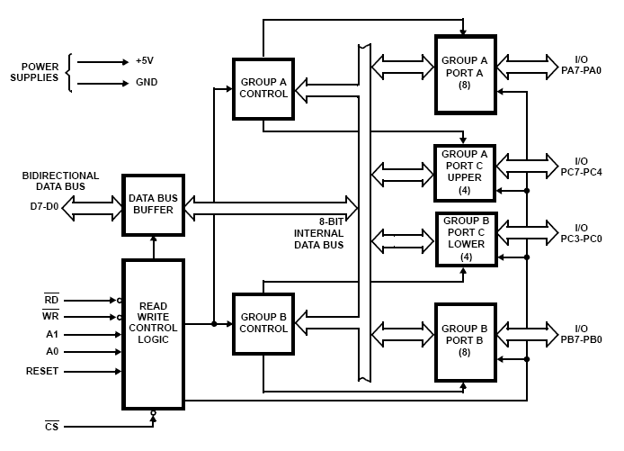
Block Diagram

Slide 10
Control Word
Can be accessed when A0=1 and A1=1
Cannot be accessed for read operation
Steps to communicate with 8255
Determine the addresses of port A,B and C and control register according to CS and A0 ,A1
Write control word in control register
Write I/O instruction to communicate with peripheral through A,B and C

Slide 11
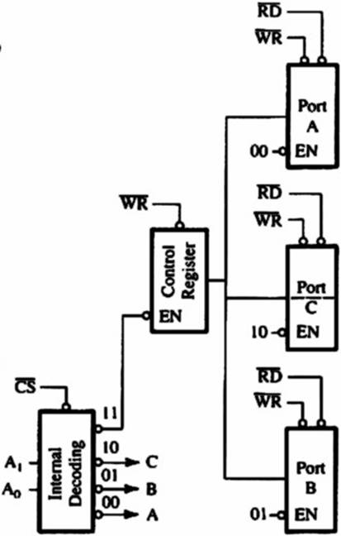
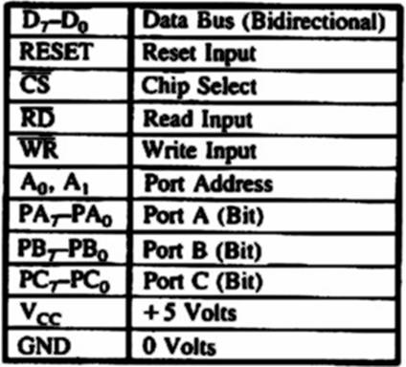
Expanded version of the Control logic.

Slide 12
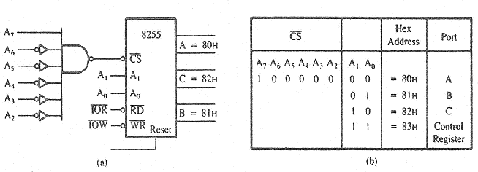
8255 Chip select Logic & I/O port address.

Slide 13
Control word
The contents of Control register, called the control word, specify an I/O function for each port.
This register can be accessed to write a control word when A0 and A1 are at logic 1, as mentioned previously.
The register is not accessible for a read operation.

Slide 14
Control word
Bit D₇ of the control register specifies either the I/O function or the Bit Set/Reset function.
If bit D₇ = 1 , Bits D₆-D₀ determine I/O functions in various modes.
If bit D₇ =0, port C operates in the Bit Set/Reset (BSR) mode.
The BSR control word does not affect the functions of ports A and B.

Slide 15
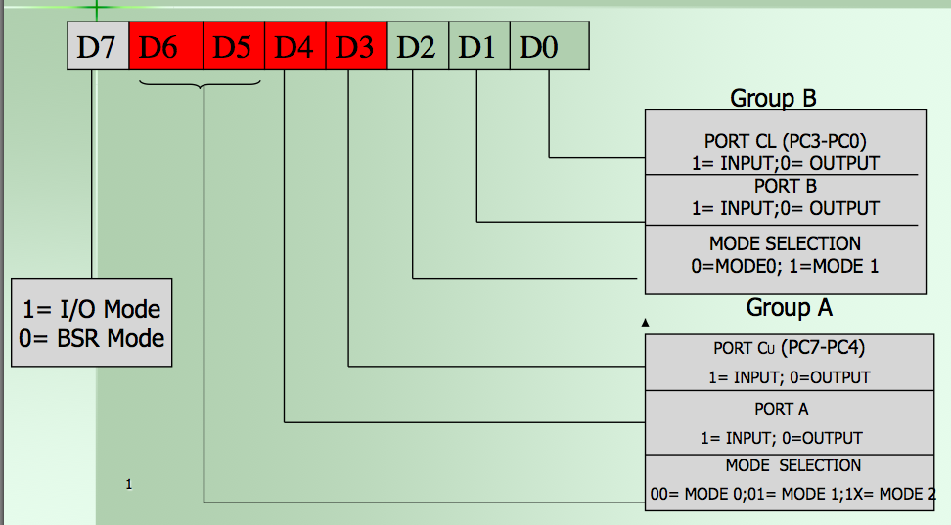
Control Word register

Slide 16
8255 Communication Process
To communicate with peripherals through the 8255A, three steps are necessary:
Determine the addresses of ports A, B, and C and of the control register according to the Chip Select logic and address lines A0 and A1.
Write a control word in the control register.
Write I/O instructions to communicate with peripherals through ports A, B, and C.

Slide 17
Mode 0: Simple Input or Output
In this mode, ports A, B are used as two simple 8-bit I/O ports and port C as two 4-bit ports. Each port can be programmed to function as simply an input port or an output port. The input/output features in Mode 0 are as follows.
Outputs are latched.
Inputs are not latched.
Ports don’t have handshake or interrupt capability.

Slide 18
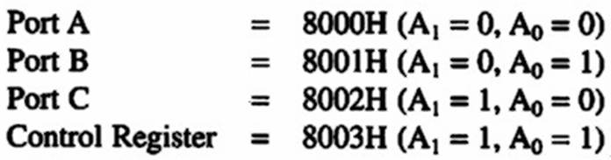
8255 PIA: Example
Solutions:
Port Address :
It is actually an I/O memory map.
When A₁₅ is active high, Chip Select signal is activated.
Assuming all don’t care signals are at logic 0, therefore ports’ address are as follows:

Slide 19
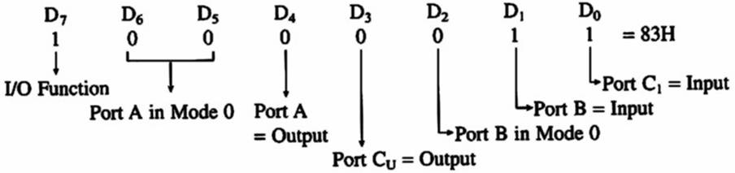
8255A Programmable Peripheral Interface
Solution:
Control Word:

Slide 20
Mode 1: Input or Output with Handshake
In this mode, handshake signals are exchanged between the MPU and peripherals prior to data transfer. The features of the mode include the following:
Two ports (A and B) function as 8-bit I/O ports. They can be configured as either as input or output ports.
Each port uses three lines from Port C as handshake signals. The remaining two lines of Port C can be used for simple I/O operations.
Input and Output data are latched.
Interrupt logic is supported.
Notes:
s

Slide 21
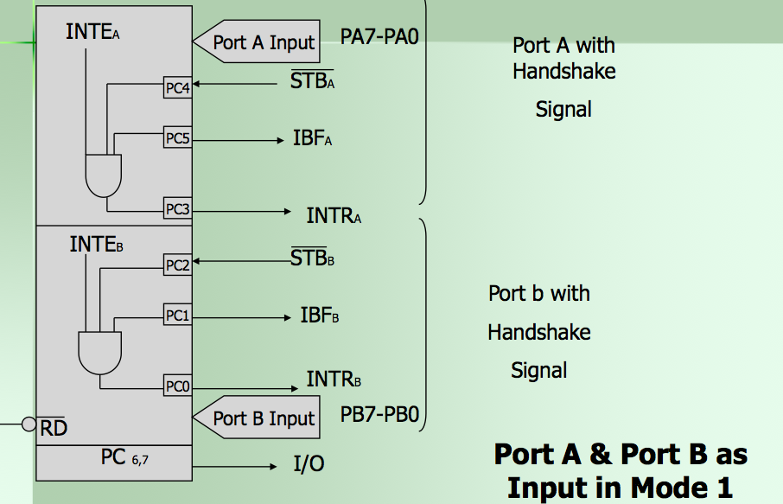
Mode 1 Input

Slide 22
Signal Description
STB- Strobe input: (active low) : generated by peripheral to indicate it has transmitted the data.
IBF( Input buffer full) : Acknowledged by 8255 to indicate the input buffer has received the data.
INTR( Interrupt Request) : This is output signal that is used to INTR the uP. This is high when STB , IBF and INTE(internal signal) is high. Means the 8255 is processing the data.
INTE (Interrupt Enable): internal flip flop

Slide 23
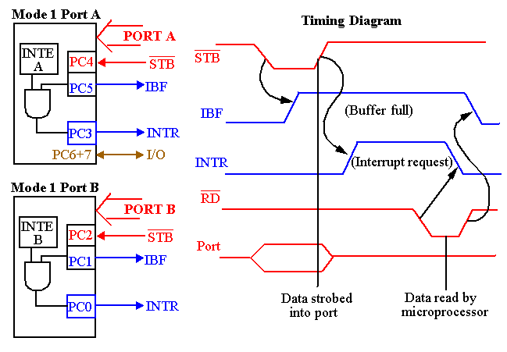

Slide 24
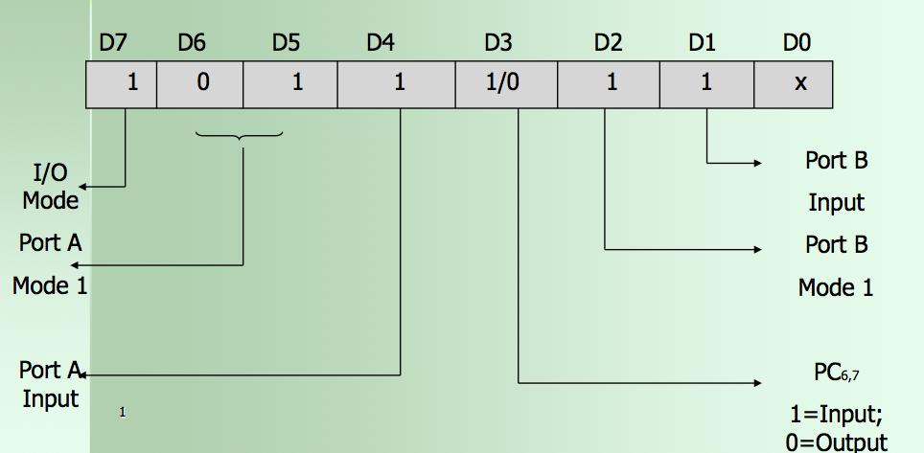
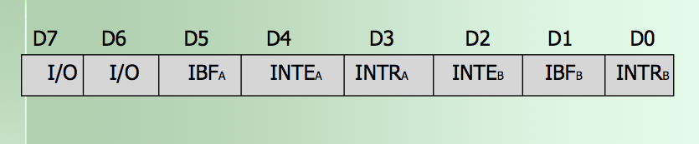
Control Word and Status Word

Slide 25
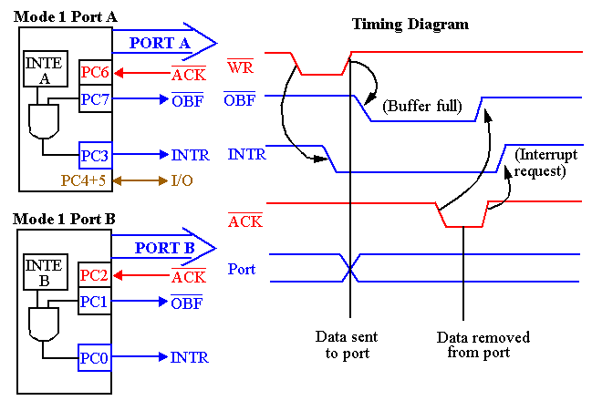
82C55 : Mode 1 Output Exam.
Notes:
Similar to Mode 0 output operation, except that handshaking signals are provided using port C.
Signal Definitions for Mode 1 Strobed Output

Slide 26
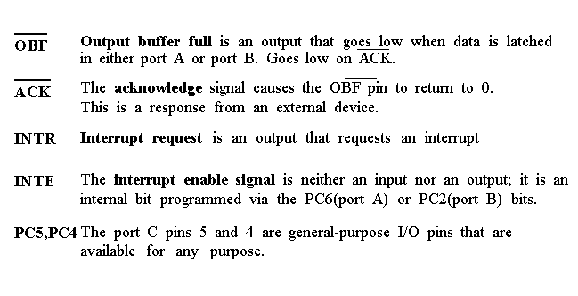
Signal Discription

Slide 27
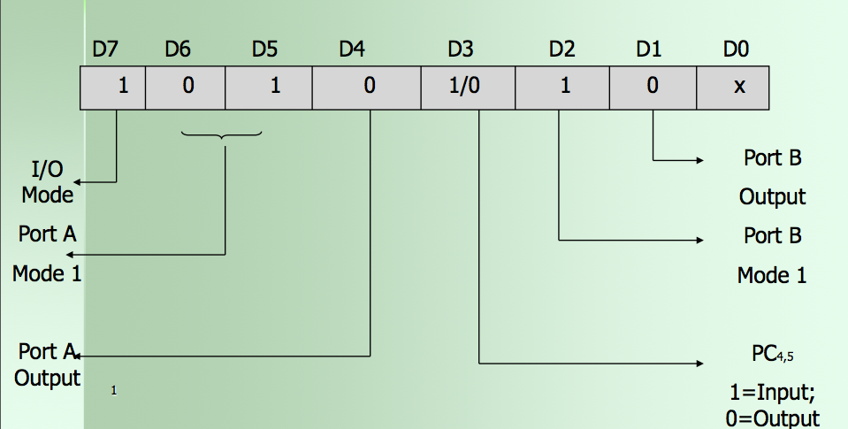
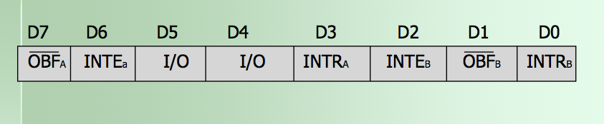
Control and Status Word

Slide 28
82C55: Mode 2 Bi-directional Operation
This functional configuration provides a means for communicating with a peripheral device or structure on a single 8-bit bus for both transmitting and receiving data (bidirectional bus I/O).
“Handshaking” signals are provided to maintain proper bus flow discipline in a similar manner to MODE 1.
Interrupt generation and enable/disable functions are also available.

Slide 29
MODE 2 Basic Functional Definitions:
Used in Group A only.
One 8-bit, bi-directional bus port (Port A) and a 5-bit control port (Port C).
Both inputs and outputs are latched.
The 5-bit control port (Port C) is used for control and status for the 8-bit, bi-directional bus port (Port A).

Slide 30
82C55: Mode 2 Bi-directional Operation
INTR : Interrupt request is an output that requests an interrupt.
~OBF : Output Buffer Full is an output indicating that that output buffer contains data for the bi-directional bus.
~ACK : Acknowledge is an input that enables tri-state buffers which are otherwise in their high-impedance state.
~STB : The strobe input loads data into the port A latch.

Slide 31
82C55: Mode 2 Bi-directional Operation
IBF : Input buffer full is an output indicating that the input latch contains information for the external bi-directional bus.
INTE : Interrupt enable are internal bits that enable the INTR pin. BIT PC6(INTE1) and PC4(INTE2).
PC2,PC1,PC0 : These port C pins are general-purpose I/O pins that are available for any purpose.

Slide 32
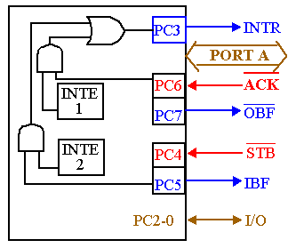
82C55: Mode 2 Bi-directional Operation
Timing diagram is a combination of the Mode 1 Strobed Input and Mode 1 Strobed Output Timing diagrams.

Slide 33
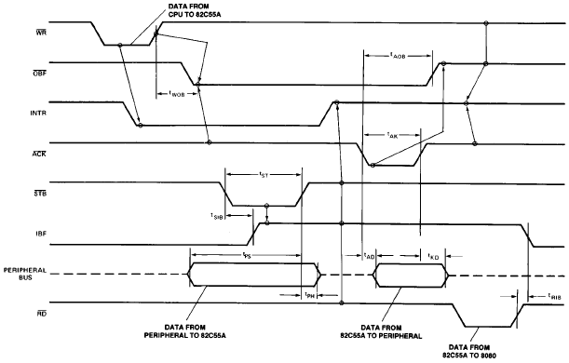
Mode 2 Timing Diagram

Slide 34
Mode 2: Bidirectional Data Transfer
This mode is used primarily in applications such as data transfer between two computers. In this mode, Port A can be configured as the bidirectional port and Port B either in Mode 0 or Mode 1.
Port A uses five signals from Port C as handshake signals for data transfer. The remaining three signals from port C can be used either as simple I/O or as handshake for port B.

Slide 35
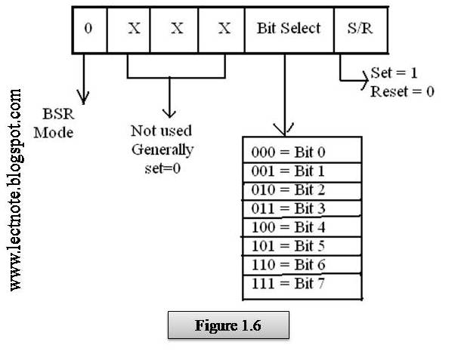
BSR Register

Slide 36
BSR (Bit Set/Reset) Mode
The BSR mode is concerned only with the eight bits of port C, which can be set or reset by writing an appropriate control word in the control register.
A control word with bit D7 =0 is recognized as a BSR control word, and it does not alter any previously transmitted control word with bit D7=1; thus the I/O operations of ports A and B are not affected by a BSR control word.
In BSR mode, individual bits of port C can be used for applications such as an on/off switch. Ports A and B are not affected by the BSR Mode.

Slide 37
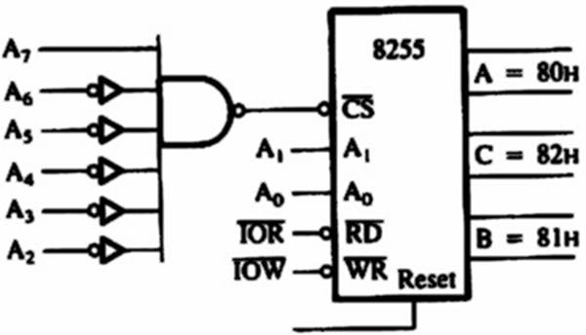
8255 PIA: BSR Mode
Example:
Write a BSR control word subroutine to set bit PC₇ and PC₃, and reset after 10ms. Use the schematic diagram as shown below.

Slide 38
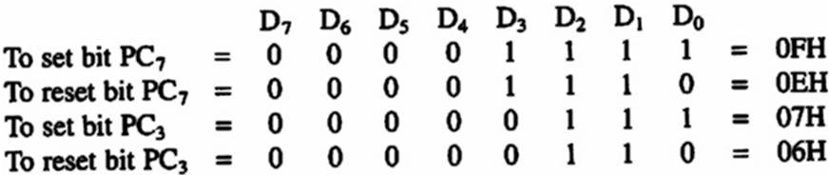
8255A Programmable Peripheral Interface
Solution:
BSR Control Word:
Port Address:
As shown in previous example : 83H

Slide 39
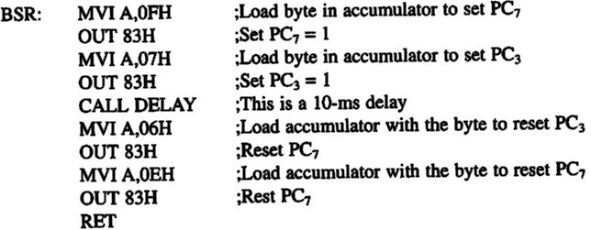
8255A Programmable Peripheral Interface
Solution:
Subroutine: Assuming that the delay subroutine has been determined earlier.

Slide 40
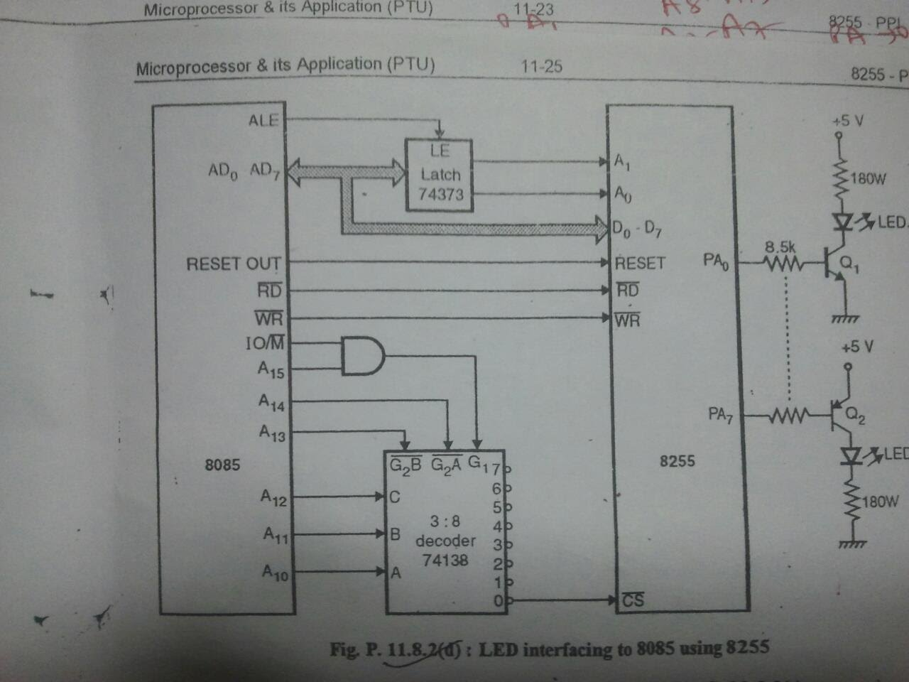
Interfacing with LED

Slide 41
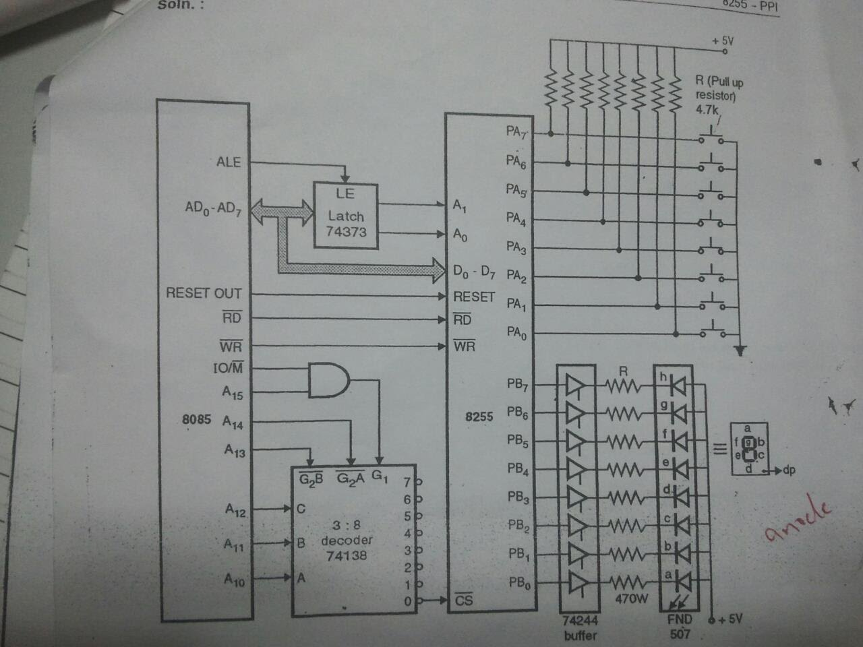
Interfacing with 7 segment

Slide 42
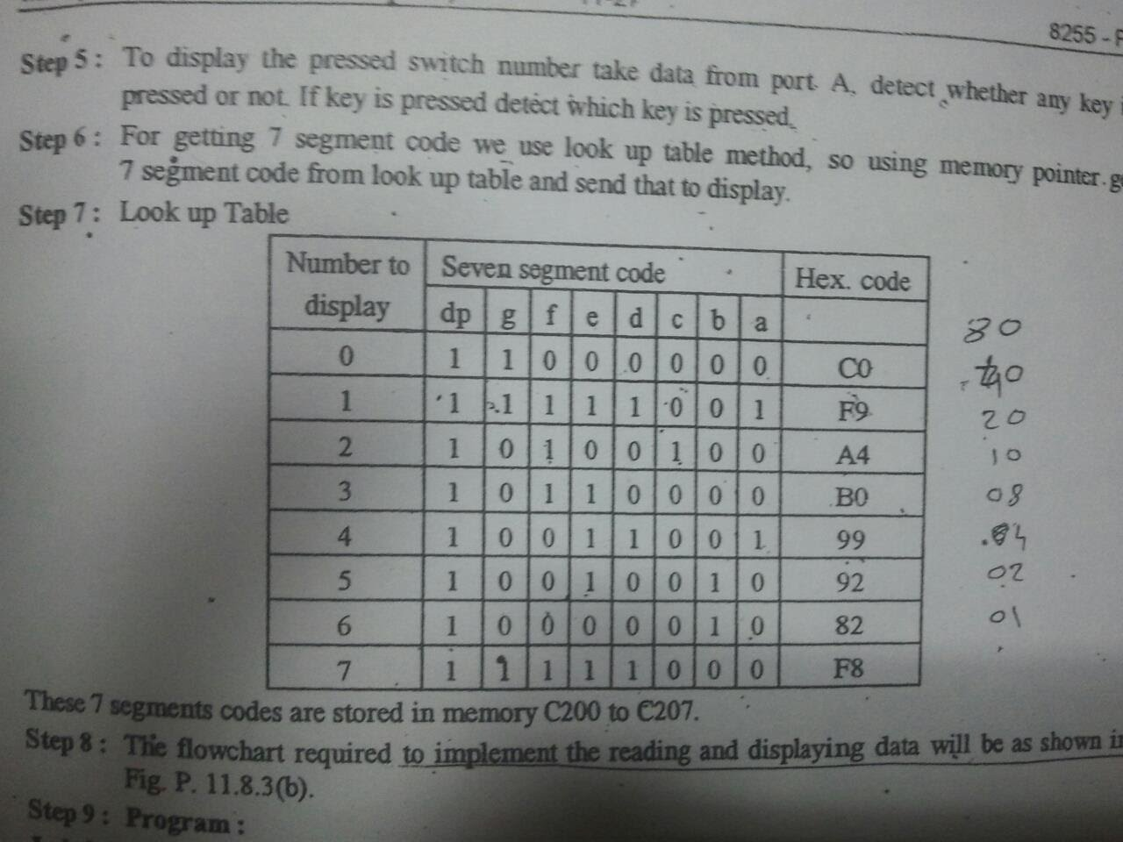
Interfacing with LED

